Slide 1
IBM Capstone_Pizza Restaurants analysis

Slide 2
Introduction
One of the filtering methods for the tourism agents and applications is the restaurant preferences. It is important to know the best places for the tourists to stay based on their eating favorites. This project will be an example of this preferences filtering. We will focus on the pizza restaurants in 5 big USA cities: New York, Chicago, San Francisco, Jersey City and Boston. The same approach can be applied for example to Indian tourists who prefer to have vegetarian food. Also, can be applied to Muslim tourists who need to eat in Halal restaurants. We study the number of restaurants and the density of them in every area inside the city.

Slide 3
Introduction
Questions that we are addressing in this project:
What is the number of pizza restaurants in every city?
Where they are mostly located in every city?
How far the restaurants located from their mean location?
Which city and location is best for pizza lovers?

Slide 4
Data
For this project we need the following data:
Nearby places in each neighborhood of the 5 cities:
Data source: Fousquare API
Description: By using this API we will get all the venues in each neighborhood.

Slide 5
Approach
Using FourSquare API we will find all venues for each neighborhood. We use the ID of the pizza restaurants.
Filter out all venues that are nearby by locality.
Use maps to check the density of the restaurants.
Assign the mean location for the high density pizza restaurants and use it as reference.
Visualize the mean and distances to determine the least distance and best location.

Slide 6
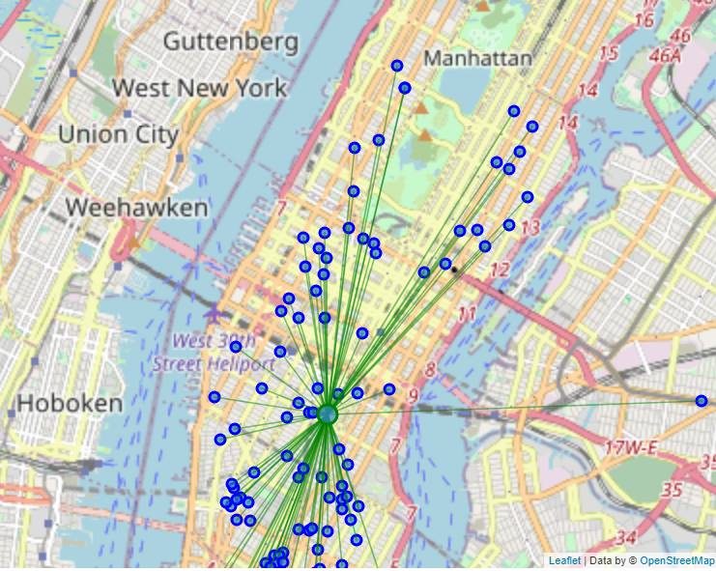
Checking the pizza density in the 5 cities using maps
New York

Slide 7
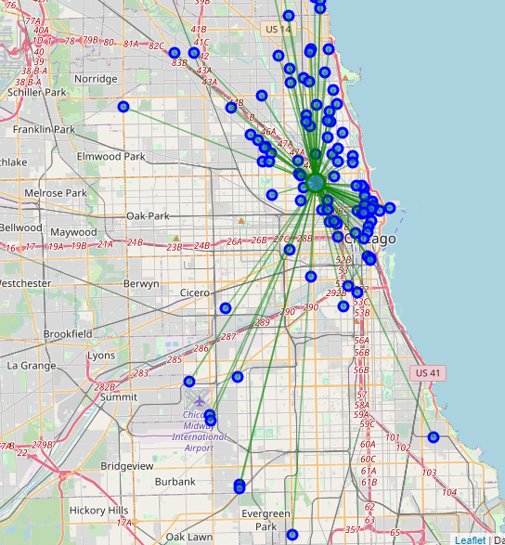
Checking the pizza density in the 5 cities using maps
Chicago

Slide 8
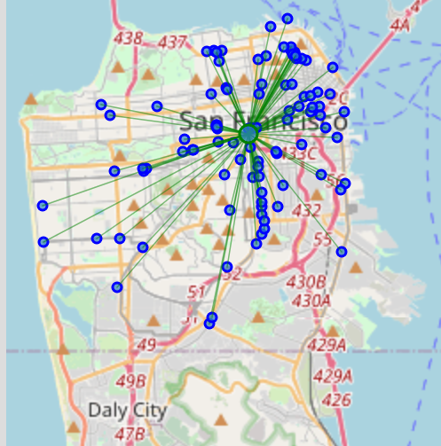
Checking the pizza density in the 5 cities using maps
San Francisco

Slide 9
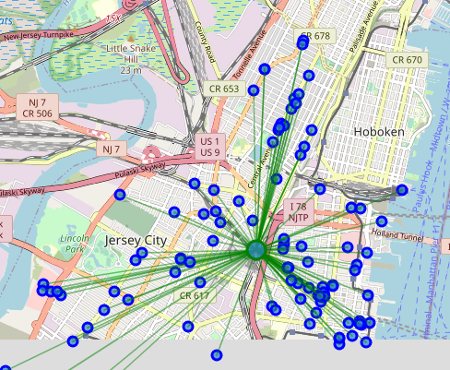
Checking the pizza density in the 5 cities using maps
Jersey City

Slide 10
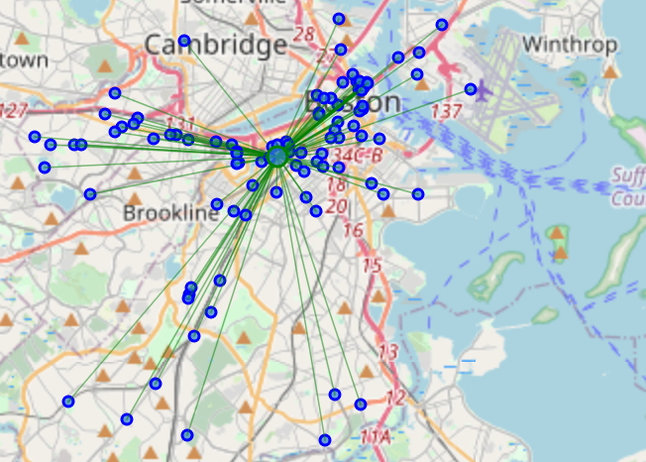
Checking the pizza density in the 5 cities using maps
Boston

Slide 11
The distances from the mean location
New York, NY
Mean Distance from Mean coordinates: 0.02355780980194641
Chicago, IL
Mean Distance from Mean coordinates: 0.05736433542465731
San Francisco, CA
Mean Distance from Mean coordinates: 0.028669570711800527
Jersey City, NJ
Mean Distance from Mean coordinates: 0.01936578522692453
Boston, MA
Mean Distance from Mean coordinates: 0.03590315981443015

Slide 12
Conclusion
It is clear that Jersey is the best option for a tourist to reserve his hotel near to the mean location and by that he will be surrounded by close 100 Pizza restaurants.

Slide 13
Thank you

